Slide 1
CompTIA A+ Guide to IT Technical Support
10th Edition

Slide 2
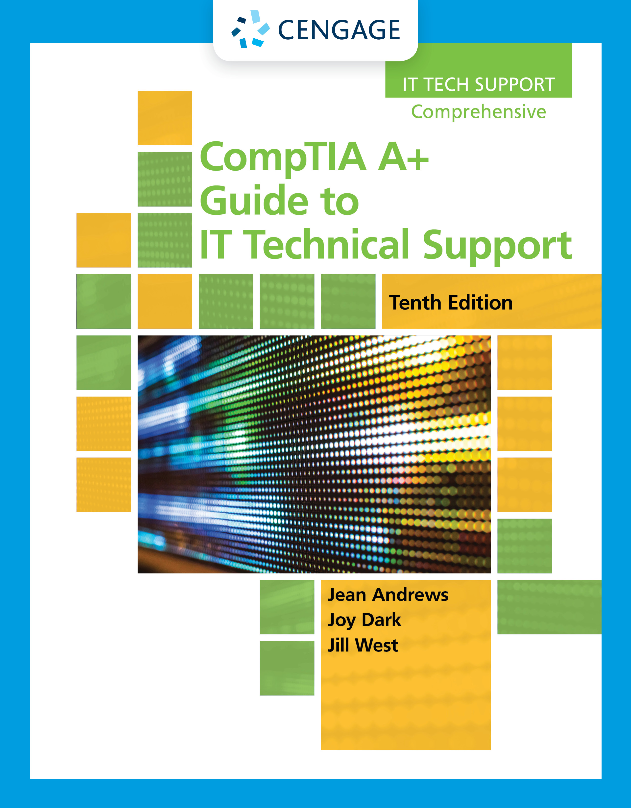
Maintaining Windows
Chapter 13

Slide 3
Objectives
Set up and perform scheduled preventive maintenance tasks to keep Windows healthy
Prepare for disaster by keeping good backups of user data, the Windows volume, and Windows system files
Use Windows tools, including Disk Management, to manage hard drives
Use commands to manage files, folders and to manage hard drives
Connect to remote computers for screen and file sharing

Slide 4
Scheduling Preventative Maintenance
Regular preventative maintenance can keep a Windows computer performing well for years
At least once a month, you need to:
Verify critical Windows settings
Clean up the hard drive

Slide 5
Verifying Critical Windows Settings
Critical Windows settings that need to be verified:
Windows updates
Antivirus/anti-malware software
Network security setting
Backups of user data, the Windows volume, and system files
To keep Windows performing well, do the following:
Uninstall software you no longer need
Clean up the hard drive

Slide 6
Patch Management
Microsoft or some other manufacturer may have a fix or patch for Windows, a device driver, or an application
Guidelines for reading error messages or documentation:
The term x86 refers to 32-bit CPUs and OSs
The term x64 refers to 64-bit OSs
All CPUs installed in personal computers today are hybrid processors that can process either 32 bits or 64 bits
The term IA64 refers specifically to 64-bit Intel processors

Slide 7
Backup Procedures
Backup
Extra copy of a data or software file
Use if original file becomes damaged or destroyed
Ways to lose data
System failure, virus, file corruption, or some other problem
Never trust important data to only one media
Always keep a copy of the data on another device or in the cloud

Slide 8
Planning for Disaster Recovery(1 of 3)
Decisions to make for a backup and recovery plan:
Decide on the type of backup
File-level backup
Image-level backup
Separate backup plan for critical applications
Decide on backup destination
Decide on the backup software
Consider purchasing third-party backup software
May offer more features than Microsoft utility
Decide how simple or complex your backup strategy should be
Large organizations might require backups be documented daily, scheduled at certain times of the day or night, and recovery plans tested regularly

Slide 9
Planning for Disaster Recovery (2 of 3)
Decisions to make for a backup and recovery plan (continued):
Consider ways of ensuring business continuity
A loss of power or Internet connection can interfere with business productivity
Use an uninterruptible power supply (UPS) to supply power when voltage drops during brownouts or short-term blackouts

Slide 10
Planning for Disaster Recovery (3 of 3)
After backup plan is in place, test the recovery plan
Test the recovery process
Erase a file and use the recovery procedures to verify that you can restore the file from backup
Keep backups in a safe place and routinely test them
Should be kept under lock and key
In case of fire, keep backups off-site
Routinely verify backups are good by performing a test recovery of a backed-up file or folder

Slide 11
Backing Up User Data and the System Image (1 of 9)
Tools offered by Windows 10/8/7 for backups:
Windows 10 offers File History or Backup and Restore
Windows 8 uses File History but not Backup and Restore
Windows 8 offers the recimg command to create a custom refresh image
Windows 7 offers Backup and Restore to back up user data and to create a system image
A system image is a backup of the entire Windows volume, including:
The Windows installation, applications, user settings, and data
The image is stored in a single file with a .wim file extension and is a compressed file that contains many related files

Slide 12
Backing Up User Data and the System Image (2 of 9)
Windows 10/8 File History
Backs up user data stored in several locations, including:
Documents, Music, Videos, and Desktop folders, and offline OneDrive files
To use:
Connect your backup device and in the Settings app, click Update & Security, then click Backup
When you click Add a drive, Windows searches for a useable drive
Select the drive or click Show all network locations to find and select a drive on the network
To manage backups, click More Options
On the Backup options window, set how often backups are made and how long old backups should be kept
File History can also be accessed through Control Panel

Slide 13
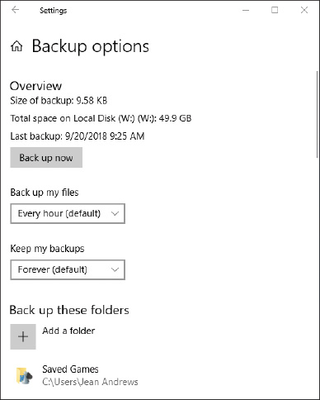
Backing Up User Data and the System Image (3 of 9)
Figure 13-2 Backup options for File History

Slide 14
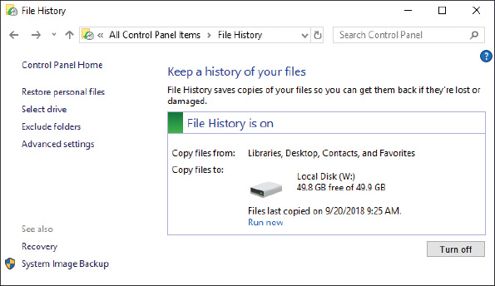
Backing Up User Data and the System Image (4 of 9)
Figure 13-3 Control File History settings and restore files from backup

Slide 15
Backing Up User Data and the System Image (5 of 9)
Restore Files and Folders in File History
To restore a file or folder from backup:
Open the File History window from Control Panel and click Restore personal files
Use left/right arrow keys on either side of the green button at the bottom of the window to select a backup and drill down into a backup to find the file or folder
Select an item and click Restore button
To save in a different location, right-click the Restore button and click Restore to
Another way to restore a file or folder from backup is to use File Explorer or Windows Explorer
Right-click the file or folder and select Restore previous versions from the shortcut menu
Copy the original file or folder before you restore in case you need to revert back to the copy

Slide 16
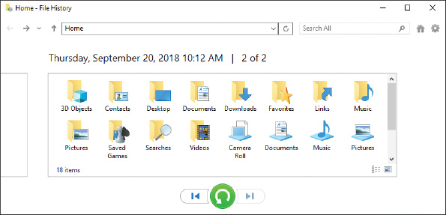
Backing Up User Data and the System Image (6 of 9)
Figure 13-4 Drill down into backups to find what you want to restore

Slide 17
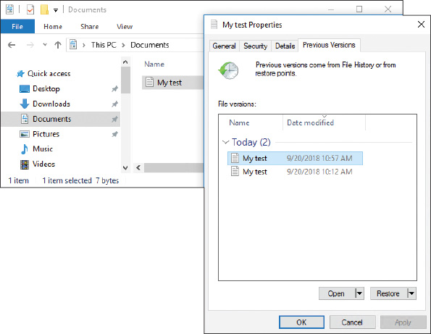
Backing Up User Data and the System Image (7 of 9)
Figure 13-5 Restore a file or folder from a previous version

Slide 18
Backing Up User Data and the System Image (8 of 9)
Windows 10/7 Backup and Restore
To save a backup and set up an ongoing backup schedule using Backup and Restore:
1. Open Control Panel and click Backup and Restore
2. Select the device or location to hold the backup
3. In the next box, select Let me choose so you can select the folder to backup, then click Next
4. In the next box, select the folders you want to back up, click Next to continue
5. Verify the correct folders and libraries are selected and click OK
You can also change the frequency in this step
6. Review your backup settings and click Save settings and run backup

Slide 19
Backing Up User Data and the System Image (9 of 9)
Maintain a System Image
Points to keep in mind when creating a system image and using it to recover a failed Windows volume:
Creating a system image takes some time
A system image includes the entire drive C: or other drive on which Windows is installed
Don’t depend just on the system image as your backup
You can create a system image any time after Windows is installed, and then you can use this image to recover from a failed hard drive

Slide 20
Backing Up Windows System Files with System Protection (1 of 3)
Windows System Protection – automatically backs up system files and stores them at regular intervals
These snapshots of the system are called restore points
Includes Windows system files that have changed since the last restore point was made
System Restore (rstrui.exe) restores the system to its condition at the time a restore point was made
User data on the hard drive will not be altered
But, you can affect installed software and hardware, user settings and passwords, and OS configuration settings

Slide 21
Backing Up Windows System Files with System Protection (2 of 3)
Enable System Protection
System Protection is turned off by default in Windows 10
To enable:
Open Control Panel and open the System window
Click System protection and make sure protection is turned on for the drive containing Windows
Restore points are normally kept in a folder named C:\System Volume Information
Restore points are taken at least every 24 hours
Can use up to 15 percent of disk space
If disk space gets too low, restore points are no longer made
You can manually create restore points at any time using the System Protection tab of System Properties

Slide 22
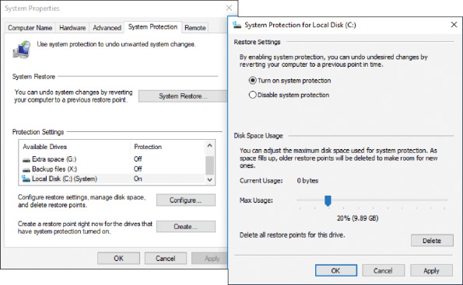
Backing Up Windows System Files with System Protection (3 of 3)
Figure 13-9 Make sure System Protection is turned on for the volume on which Windows is installed

Slide 23
Managing Files, Folders, and Storage Devices
In this part of the chapter, you learn:
How files, folders, and volumes on a hard drive are organized
How to manage hard drive partitions and volumes using the Disk Management utility
How to improve hard drive performance

Slide 24
How Partitions and File Systems Work (1 of 5)
Low-level formatting is a process (usually performed at the factory) that organizes the space in a long series of logical blocks; this is called Logical Block Addressing (LBA)
The drive is further organized into one or more partitions using one of two partitioning systems:
MBR partitions – keeps a map of partitions in a partition table stored at the beginning of the hard drive called the MBR
Can have up to three primary partitions (also called volumes)
A fourth partition (called extended partition) can hold one or more volumes called logical drives
GPT partitions – the Globally Unique Identifier Partition Table (GUID or GPT) system can support up to 128 partitions and is required for drives larger than 2.2 TB
First sector in a GPT system contains the protective MBR, which provides information to legacy software that does not support GPT
All partitions are tracked in a single partition table, stored in the GPT header

Slide 25
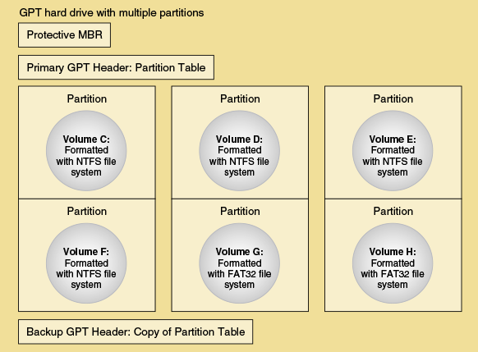
How Partitions and File Systems Work (2 of 5)
Figure 13-11 A hard drive using GPT partitioning

Slide 26
How Partitions and File Systems Work (3 of 5)
Windows File Systems
Before a partition or drive can be used it must be:
Assigned a drive letter (C: or D:)
Formatted using a file system
File system is the overall structure an OS uses to name, store, and organize files on a drive
File systems supported by Windows:
NTFS – uses smaller allocation unit or cluster sizes than FAT32 (more efficient)
ReFS – Resilient File System (ReFS) is designed to improve on the NTFS file system by offering better fault tolerance and allowing for better compatibility with virtualization and data redundancy
NFS – Network File System is a client/server file system that supports file sharing over a network across platforms

Slide 27
How Partitions and File Systems Work (4 of 5)
Windows File Systems (continued)
File systems supported by Windows (continued):
exFAT – use for large external storage devices to be used with other operating systems
FAT32 – use for small hard drives or USB flash drives
CDFS(Compact Disc File System) and UDF – CDFS is an older file system used by optical discs and is being replaced by UDF (Universal Disc Format)

Slide 28
How Partitions and File Systems Work (5 of 5)
How Partitions are Used During the Boot
With MBR hard drives, one of the primary partitions is designated the active partition, which is the bootable partition that startup BIOS/UEFI look to when searching for an OS
In GPT system, the bootable partition is called the EFI System Partition (ESP)
UEFI turns to it to find and start the OS
In Windows, the MBR active partition or the GPT ESP is called the system partition
For Windows 10/8/7, the boot manager program is named BootMgr (no file extension)
Boot manager turns to the volume that is designated the boot partition, where the Windows OS is stored

Slide 29
Using Disk Management to Manage Hard Drives (1 of 19)
Disk Management is the primary tool for managing hard drives
Manage partitions, prepare a new drive for first use, mount a drive, use Windows dynamic disks, and troubleshoot problems with the hard drive
Resize, Create, and Delete Partitions
To shrink a volume using Disk Management, right-click in the partition space and select Shrink Volume from the shortcut menu
Enter the amount in MB to shrink the partition (be sure to leave at least 20 percent free space on the existing partition), click Shrink
To create a new partition in the unallocated space, right-click the space and select New Simple Volume
Follow the onscreen directions to enter the size of the volume in MB, select a drive letter for the volume, and select a file system (leave the Allocation unit size at Default)

Slide 30
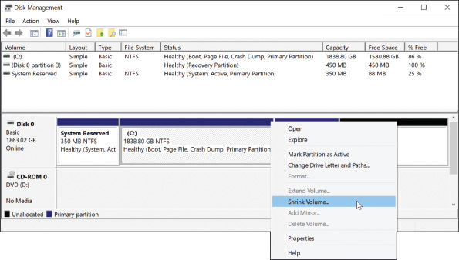
Using Disk Management to Manage Hard Drives (2 of 19)
Figure 13-14 Shrink a volume to make room for a new partition

Slide 31
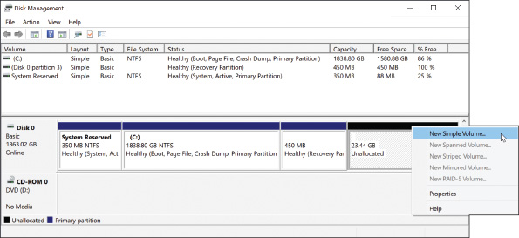
Using Disk Management to Manage Hard Drives (3 of 19)
Figure 13-15 Use unallocated space to create a new partition

Slide 32
Using Disk Management to Manage Hard Drives (4 of 19)
Prepare a Drive For First Use
To prepare a drive for first use:
Step 1: Initialize the disk
When initialized, Windows identifies the disk as a basic disk, which is a single hard drive that works independently of other hard drives
Step 2: Create a volume and format it with a file system
Right-click in the unallocated space, select New Simple Volume from the shortcut menu, and follow directions on-screen

Slide 33
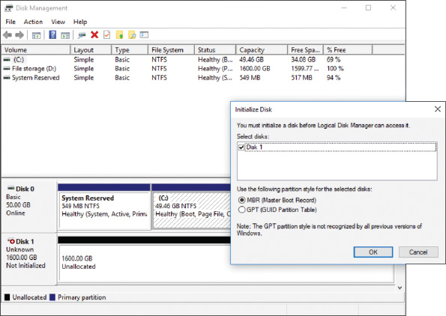
Using Disk Management to Manage Hard Drives (5 of 19)
Figure 13-16 Use the Initialize Disk box to set up a partitioning system on new hard drives

Slide 34
Using Disk Management to Manage Hard Drives (6 of 19)
How to Mount a Drive
A mounted drive is a volume accessible by a folder on another volume
So the folder has more available space
Useful when a folder is on a volume that is too small to hold all the data
Mount point: C:\Projects folder
Follow these steps:
Volume that will host the mounted drive must use NTFS file system
Using Disk Management, right-click in the unallocated space, select New Simple Volume and use the wizard to specify the amount of unallocated space you want to devote to the volume
Follow steps in the wizard and select Mount in the following empty NTFS folder, browse for existing folder or click New Folder to create a new folder on drive C:

Slide 35
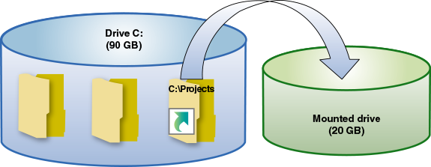
Using Disk Management to Manage Hard Drives (7 of 19)
Figure 13-17 The C:\Projects folder is the mount point for the mounted drive

Slide 36
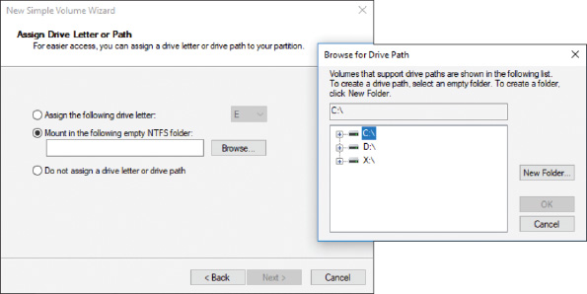
Using Disk Management to Manage Hard Drives (8 of 19)
Figure 13-18 Select the folder that will be the mount point for the new volume

Slide 37
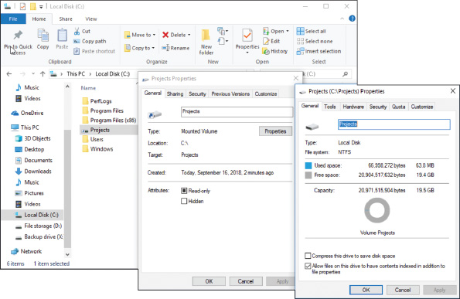
Using Disk Management to Manage Hard Drives (9 of 19)
Figure 13-19 The mounted drive in Explorer appears as a very large folder

Slide 38
Using Disk Management to Manage Hard Drives (10 of 19)
Windows Dynamic Disks
Several dynamic disks can work together to collectively present a single dynamic volume
Data to configure each hard drive is stored in a disk management database (resides in last 1 MB of space on each hard drive)
Three uses of dynamic disks:
For better reliability, configure a hard drive as a dynamic disk and allocate the space as a simple volume
Implement dynamic disks on multiple hard drives to extend a volume across these drives (called spanning)
Can be used to piece data across multiple hard drives to improve performance and/or provide fault tolerance

Slide 39
Using Disk Management to Manage Hard Drives (11 of 19)
Windows Dynamic Disks (continued)
RAID (redundant array of inexpensive disks or redundant array of independent disks) is the technology to configure two or more hard drives to work together as an array of drives
Joining hard drives to improve performance is called striping or RAID 0 (work is shared between two hard drives but does not provide fault tolerance)
Copying one hard drive to another as a backup is called mirroring or RAID 1 (improves fault tolerance because if one drive fails, you have another copy)
RAID implemented using Disk Management is called software RAID
Use BIOS/UEFI setup on a motherboard that support RAID, which is called hardware RAID

Slide 40
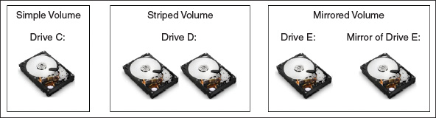
Using Disk Management to Manage Hard Drives (12 of 19)
Figure 13-20 A simple volume is stored on a single disk, but a striped volume or a mirrored volume is stored on an array of dynamic disks

Slide 41
Using Disk Management to Manage Hard Drives (13 of 19)
Windows Dynamic Disks (continued)
You can use Disk Management to convert two or more basic disks to dynamic disks
Use unallocated space on these disks to create a simple volume or a Windows array of disks using a spanned, striped, or mirrored volume
To convert a basic disk to dynamic, right-click the Disk area and select Convert to Dynamic Disk from the shortcut menu
Right-click free space on the disk and select New Simple Volume, New Spanned Volume, New Striped Volume, or New Mirrored Volume

Slide 42
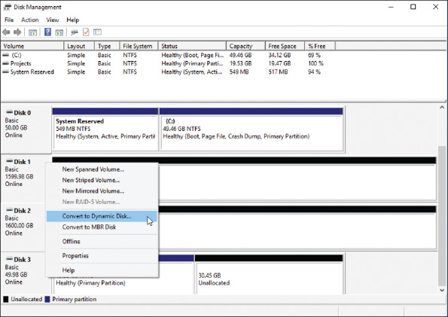
Using Disk Management to Manage Hard Drives (14 of 19)
Figure 13-21 Convert a basic disk to a dynamic disk

Slide 43
Using Disk Management to Manage Hard Drives (15 of 19)
Windows Storage Spaces
Storage Spaces in Windows 10/8 is a potential replacement for software RAID
With Storage Spaces, you can create a storage pool using any number of internal and external backup drives
Create one or more virtual drives, called spaces, from this pool
Appear as normal drives in File Explorer
Storage spaces is designed for resiliency, which resists data loss in the event of drive failure
Storage options:
Simple
Two-way mirroring
Three-way mirroring
Parity

Slide 44
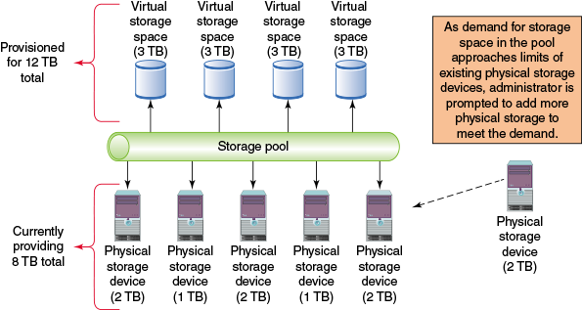
Using Disk Management to Manage Hard Drives (16 of 19)
Figure 13-22 Thin provisioning allows for additional physical devices as needed without reconfiguring space available for to users

Slide 45
Using Disk Management to Manage Hard Drives (17 of 19)
To set up a system to use Storage Spaces, do the following:
Attach any drives to the computer you intend to use for your storage pool
In Classic view of Control Panel, click Storage Spaces, click Create a new pool and storage space, respond to the UAC box
Any drives that are compatible with Storage Spaces will be listed
Select the drives to format, click Create pool to prepare the drives
After the drives are ready, use the Create a storage space window to assign a name and drive letter for the storage space and select a file system
Select a resiliency type, adjust the maximum size of the storage pool (if you plan to use thin provisioning), click Create storage space
After the storage space is created, you can return to the Storage Spaces window to change the name, drive letter, and size of an existing storage space

Slide 46
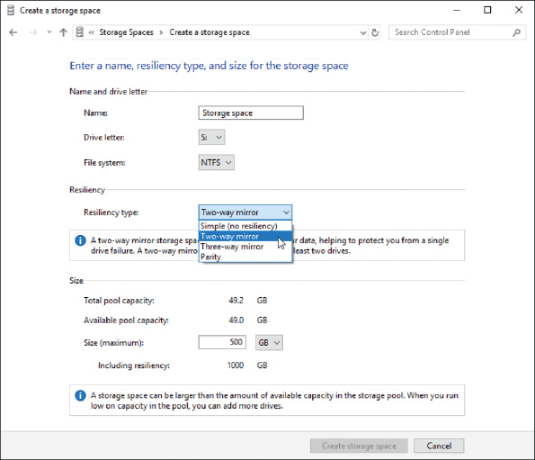
Using Disk Management to Manage Hard Drives (18 of 19)
Figure 13-23 Define the resiliency type for the new storage space

Slide 47
Using Disk Management to Manage Hard Drives (19 of 19)
Use Disk Management to Troubleshoot Hard Drive Problems
Drive and volume statuses:
Healthy
Failed
Online
Active
EFI System Partition
Unallocated
Formatting
Basic
Dynamic

Slide 48
Improving Hard Drive Performance
Windows needs at least 15 percent free space on the hard drive
Uses it as working space
Uninstall software you no longer need and delete unneeded files occasionally
Disk Management includes a Disk Cleanup (cleanmgr.exe) utility
Deletes temporary files on the drive
A hard drive can be optimized to improve performance:
For magnetic hard drives, Windows automatically defragments the drive once a week
To defragment is to rearrange fragments or parts of files on the drive so each file is stored on the drive in contiguous clusters
For SSDs, Windows automatically trims the drive weekly
To trim an SSD is to erase a block on the drive that is filled with unused data

Slide 49
Using a Command-Line Interface (CLI) (1 of 2)
Windows has two levels of command prompt windows
Standard window – the default directory is the currently signed-in user’s folder
Commands requiring administrative privileges will not work
To open a standard command prompt window:
Enter command or cmd in the Windows 10/7 search box or the Windows 8 Run box, then click Command Prompt
Elevated window – requires the user to be signed-in as an administrator
The word “Administrator” will appear in the title bar
Default directory will be C:\Windows\system32
To open an elevated command prompt window:
Type cmd or command in the Windows 10/7 search box or the Windows 8 Run box, right-click Command Prompt, and click Run as administrator

Slide 50
Using a Command-Line Interface (CLI) (2 of 2)
Tips for working in a command prompt window:
Type cls and press Enter to clear the window
Press the up arrow to retrieve the last command
Press the right arrow to retrieve the last command line one character at a time
Press Ctrl+C, Ctrl+Break or Ctrl+Pause to terminate a command before it is finished
To access settings for the command prompt window, right-click the title bar and click Properties
Type exit and press Enter to close the window

Slide 51
Commands to Manage Files and Folders (1 of 3)
File-Naming Conventions
Filename and file extension characters can be:
Letters a through z and numbers 0 through 9
Characters: _ ^ $~ ! # % & – { } ( ) @ ' `
Filename with spaces:
Enclose filename in double quotation marks
Wildcard Characters in Command Lines
Question mark (?) is a wildcard for one character
Asterisk (*) is a wildcard for one or more characters
Example, if you want to find all files in a directory that start with A and have a three-letter file extension, use the following command:
dir a*.???

Slide 52
Commands to Manage Files and Folders (2 of 3)
help or <command name> /?
Use the help command to get help about any command
Enter help followed by the command name or enter the command name followed by /?
dir [<filename>] [/p] [/s] [/w]
List files and directories
cd [<drive>:\[path]] or cd..
Changes current default directory
Use .. after CD to move from child directory to its parent directory
Example:
C:\> cd C:\game\chess
The command prompt now looks like this:
C:\game\chess>

Slide 53
Commands to Manage Files and Folders (3 of 3)
copy [/v] [/y] <source> [<destination>]
The copy command copies a single file or group of files
To copy a file from one drive to another, use a command similar to this one:
E:\> copy C:\Data\Myfile.txt E:\mydata\Newfile.txt
Useful switches or parameters
/v: the size of each new file compared to the size of original file
/y: a confirmation message does not ask you to confirm before overwriting a file
xcopy <source> [<destination>] [/s] [/c] [/y] [/d:date]
The xcopy command is more powerful than the copy command
robocopy <source> [<destination>] [/s] [/e] [/log:filename] [/log+:filename] [/move] [/purge]
The robocopy (robust file copy) command is similar to xcopy, but offers more options than xcopy and is intended to replace xcopy

Slide 54
Commands to Manage Hard Drives (1 of 2)
chkdsk [<volume>:] [/f] [/r]
Fixes file system errors and recovers data from bad sectors
Used with the /f parameter, chkdsk searches for and fixes two types of file system errors made by the FAT or MFT:
Lost clusters (also called lost allocation units)
Cross-linked clusters
Used with the /r parameter, chkdsk checks for lost clusters, cross-linked clusters, and bad sectors on the drive
To check the hard drive for file system errors and repair them, use this command:’
chkdsk c:/f

Slide 55
Commands to Manage Hard Drives (2 of 2)
defrag [<volume>:] [/C]
Examines a magnetic hard drive for fragmented files and rewrites fragmented files to the drive in contiguous clusters
Requires an elevated command prompt window in Windows
format <volume:> [/q] [fs:<filesystem>]
Used to format a hard drive or other storage device
shutdown [/i] [/r] [/s] [/m \\<computername>] [/t xx]
Shut down the local computer or a remote computer
You must be signed in with an administrator account

Slide 56
Windows 10 PowerShell and Ubuntu Bash Interfaces (1 of 6)
The three CLI offered by Windows 10 are the Command Prompt, PowerShell, and Linux shell interfaces
PowerShell
Designed to replace the command prompt utility
Processes objects called cmdlets that essentially run prebuilt programs, similar to batch files
Technicians or programmers who program their own cmdlets can build customized objects using existing cmdlets as building blocks

Slide 57
Windows 10 PowerShell and Ubuntu Bash Interfaces (2 of 6)
PowerShell Cmdlet Syntax
Native PowerShell cmdlet syntax almost always starts with a verb followed by a noun, connected by a hyphen
Example:
Get-ChildItem
Some cmdlets have parameters, such as –Depth in the GetChildItem cmdlet
Allows you specify how many layers to search in the targeted location
Example:
Get-ChildItem –Recurse –Depth 2 delivers a list of items in the current folder, that folder’s child folders, and the folders within those child folders

Slide 58
Windows 10 PowerShell and Ubuntu Bash Interfaces (3 of 6)
Cmdlet | Description
Get-Item | Retrieves files and folders
Get-Process | Retrieves the processes running on a computer
Set-Location | Changes the current working location to a specified location
Copy-Item | Copies an item to a specified location
Remove-Item | Deletes an item
Get-Verb | Shows a list of all cmdlet verbs
Get-Verb *.Location | Shows a list of all cmdlet verbs available for a specific noun, where the asterisk is a wildcard in place of any verb attached to the noun Location
Get-Command | Shows a list of all available cmdlets

Slide 59
Windows 10 PowerShell and Ubuntu Bash Interfaces (4 of 6)
Basic cmdlet features you should know:
Aliases for command prompt commands
An alias is a nickname or shortcut for a cmdlet
Example: one default alias for Get-ChildItem is dir
List of aliases
Get-Alias shows all the available aliases in the current session
Help
To find the cmdlet assigned to a specific alias, use the Help cmdlet

Slide 60
Windows 10 PowerShell and Ubuntu Bash Interfaces (5 of 6)
Ubuntu Bash on Windows
Microsoft built a Linux shell into Windows 10 that provides a shell prompt to enter Linux commands
The new shell requires a Windows component, Windows Subsystem for Linux (WSL)
Installs a subset of the Ubuntu distribution of Linux
Ubuntu provides Bash (the most popular shell)
Called Bash on Ubuntu on Windows, Bash on Windows, or Ubuntu Bash
WSL runs on any 64-bit Windows 10 system with the Anniversary Update build 14393 or later
You must first turn on Developer Mode and then enable the Windows Subsystem for Linux (Beta) feature

Slide 61
Windows 10 PowerShell and Ubuntu Bash Interfaces (6 of 6)
Command Prompt | PowerShell | Ubuntu Bash
dir | Get-ChildItem | ls
ipconfig | Get-NetIPConfiguration Get-NetIPAddress | ifconfig iwconfig
ping | Test-NetConnection | ping
cd | Set-Location | cd
tasklist | Get-Process | ps
help command command /? | Get-Help command | command -help
exit | Exit | exit

Slide 62
Remote Connections
Windows 10/8/7 offers:
Remote Desktop Connection (RDC) for screen and file sharing
Remote Assistance to assist users by screen sharing
Windows 10 offers a new option to remotely assist a user:
Quick Assist
Third-party software for a remote connection is also available

Slide 63
Remote Desktop Connection (RDC)
Remote Desktop Connection (RDC) gives a user access to a Windows desktop from anywhere on the Internet
RDC is also called Remote Desktop
To use Remote Desktop, the computer you want to remotely access (the server) must be running business or professional editions of Windows 10/8/7
The computer you’re using to access it can be running any version of Windows
Computers set to serve up Remote Desktop are not as secure
Take this into account when you decide to use Remote Desktop

Slide 64
Remote Assistance (1 of 2)
Remote Assistance differs from Remote Desktop
A user on the server computer can remain signed in during the remote session, retains control of the session, and can see the screen
Helpful when troubleshooting problems on a computer
Ways to initiate a Remote Assistance session:
User saves an invitation file and then sends that file to the technician
User can send an automated email through the Remote Assistance app
The user can use Easy Connect (both computers used for the connection must be using Windows)
The technician can initiate a session
Follow steps outlined in text to see how to initiate a Remote Assistance connection by sending an invitation to the technician

Slide 65
Remote Assistance (2 of 2)
Things you can do during a Remote Assistance session:
Chat
Request control
Pause – user can hide his desktop from you at any time by clicking Pause
Disconnect or Stop sharing
Log activity in a log file
Change expiration of invitations

Slide 66
Third-Party Remote Access
Remote Desktop and Remote Assistance require you to open a port on your network
A security risk
Third-party remote access software executed from a browser window is more secure
The browser initiates communication outside the protected network
Open listening ports are not required
Examples of this type of software:
TeamViewer
GoToMyPC by Citrix
LogMeIn
Zoom

Slide 67
Chapter Summary (1 of 3)
Regular preventative maintenance includes verifying Windows Update, anti-malware, and network security settings, uninstalling software you no longer need, and cleaning up and optimizing the hard drive
Apply 32-bit patches to 32-bit applications and OSs and 64-bit patches to 64-bit applications and OSs
You need a plan for disaster recovery in the event the hard drive fails
You can back up to local storage or to the cloud
Windows 10/8 File History and Windows 10/7 Backup and Restore can be used to schedule routine backups of user data files
The best time to create a system image is right after you’ve installed Windows, hardware, applications, and user accounts and customized Windows settings
A Windows 8 custom refresh image backs up the entire Windows volume

Slide 68
Chapter Summary (2 of 3)
System Protection creates restore points, which include Windows system files that have changed since the last restore point was made
The MBR partitioning system can support only three primary partitions and one extended partition
The GPT partitioning system can support up to 128 partitions and hard drives larger than 2.2 TB
Windows file systems include NTFS, ReFS, NFS, exFAT, FAT32, CDFS, and UDF
An MBR hard drive has a designated active partition and GPT drives have a designated EFI System Partition that contains the Windows boot manager program
Use Disk Management to manage hard drives and partitions
Windows Storage Spaces is expected to replace the Windows solution for software RAID and can support thin provisioning

Slide 69
Chapter Summary (3 of 3)
To improve hard drive performance, use the Disk Cleanup tool and the Defragment and Optimize Drives tool to clean and optimize the drive
Command used to manage files, folder, and storage media include help, dir, cd, copy, xcopy, robocopy, chkdsk, defrag, format, and shutdown
The PowerShell command-line interface uses cmdlets with parameters
Remote Desktop gives you access to your Windows desktop and file sharing from anywhere on the Internet
When using Remote Assistance, the user on the host computer can remain signed in during the remote session, retains control of the session, and can see the screen
When evaluating third-party remote access applications, consider how screens and files are shared and the security of the connection

